Slide 1




NEURAL NEXUS
VIBE CAST
MUSICX VR.
"MUSIC FOR EVERYONE."

Slide 2





VIBE CAST VER..
ABSTRACT
The system is built using Python and employs machine learning libraries and frameworks such as scikit-learn, pandas, and NumPy. The datasets used include user listening history and song metadata. The collaborative filtering component predicts user preferences based on the behavior of similar users, while the content-based filtering component recommends items similar to those the user has liked in the past, based on item features.
The project's outcome demonstrates the effectiveness of combining collaborative filtering with content-based techniques to improve recommendation accuracy and user satisfaction. The hybrid approach leverages both user interactions and song attributes, resulting in a more comprehensive and precise recommendation system. This study highlights the potential for hybrid models to enhance personalized recommendations in the music streaming industry.

Slide 3

VISIT OUR MUSIC
INTRODUCTION
Music streaming services have revolutionized how we consume music, offering vast libraries accessible anytime and anywhere.
Personalized music recommendations are crucial in enhancing user experience by suggesting songs tailored to individual tastes.
Our project leverages collaborative filtering and content-based techniques to create a sophisticated recommendation system.
This hybrid approach aims to improve recommendation accuracy and user satisfaction, setting a new standard for music streaming services.

Slide 4



OUR MAIN AIM/OBJECTIVE : >
POP MUSIC GENRE?
Main Aim: Develop a personalized music recommendation system using a hybrid approach combining collaborative filtering and content-based techniques.
Collect user listening history and song metadata.
Extract and analyze key attributes like genre and tempo.
Build and refine collaborative and content-based models.
Integrate both techniques into a hybrid system.
Evaluate performance using precision, recall, and F1-score.
Continuously improve recommendations based on user feedback.

Slide 5



ALL OVERVIEW OF
RECOMMEDATION ENGINE
Evolution:
Music recommendation systems have evolved significantly, enhancing user experience in music streaming services.
Frameworks:
Collaborative filtering predicts preferences by analyzing similar users' behavior.
Content-based filtering recommends songs based on metadata and audio features.
Hybrid approaches combine both methods for improved accuracy.
Relevance:
Widely used in industry giants like Spotify and Apple Music to personalize user experiences and maintain engagement.

Slide 6

DATA COLLECTION
Content:
Datasets used: User listening history, song metadata
Data sources: Spotify API, imported CSV files
Key attributes in the datasets: Song ID, Title, Artist, Album, Genre, Release Year, Audio Features.
SOME BRIEF ABOUT MUSICX
Machine Learning Model is going to Predict Based on the ‘Popularity’
Where we train the Model by Root Mean Squared Values (RMS) and also implement the CNN to improve the overall Training Accuracy and show on the platform of Streamlit.

Slide 7


METHODOLOGY
MUSICX VER.
Data Collection : Importing the Datasets of (Artist_details,year_details,maindata_details) Son Meta Data.
Data Processing(Normalization and Pre-Processing.
Feature Engineering: Transforming the Existing Features (e.g: Generes)
Model-Building: Content Based Filtering, Collaboratie Filtering, Content-Based Filtering.
Hybrid Systems(Training , Testing CNN)
Evaluation: Performance Metrics like(Precision, Recall, F1-Score, Training and Testing Accuracy)

Slide 8

OUR SYSTEM
RECOMMEDATION ENGINE FILTERING
1
Collaborative Filtering:
User-based and item-based collaborative filtering
How it predicts user preferences based on similar users' behavior
2
Content-Based Filtering:
Using song metadata and audio features to recommend similar songs
Importance of attributes like genre, tempo, energy

Slide 9
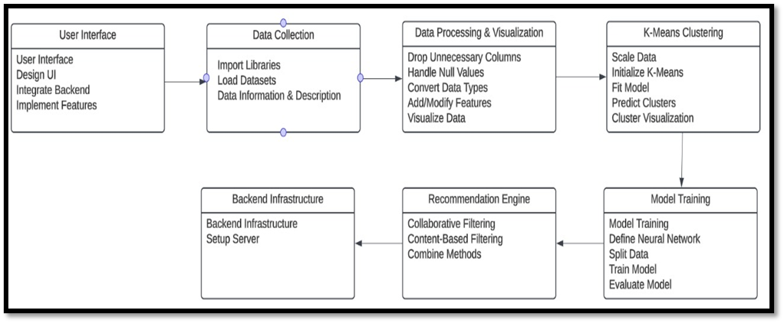
OUR SYSTEM
ARCHITECTURE

Slide 10
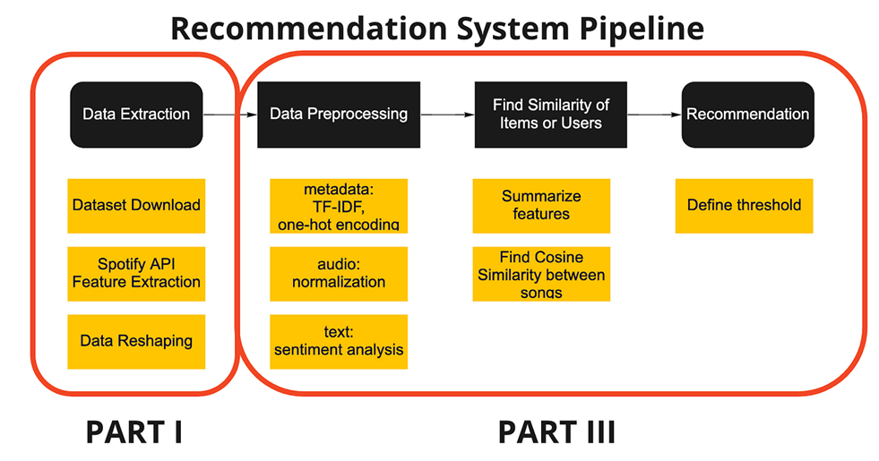
OUR SYSTEM
DIAGRAM APPROACH

Slide 11

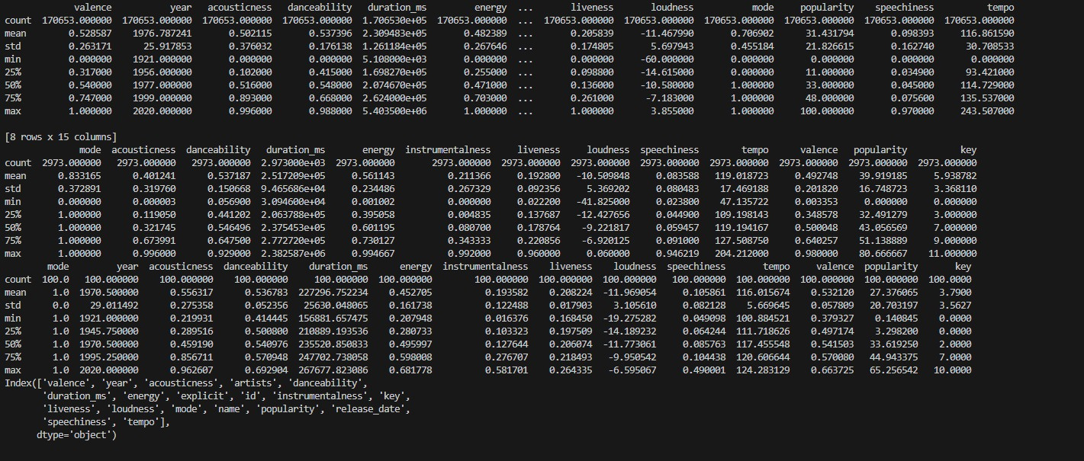
DATASETS
EVALUATIONS & VALUES

Slide 12
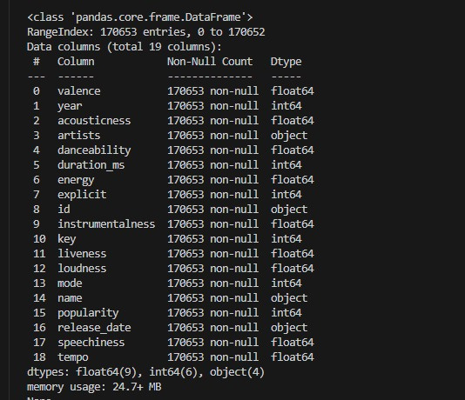
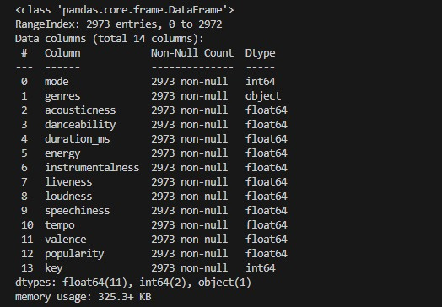
DATASETS
EVALUATIONS & VALUES

Slide 13
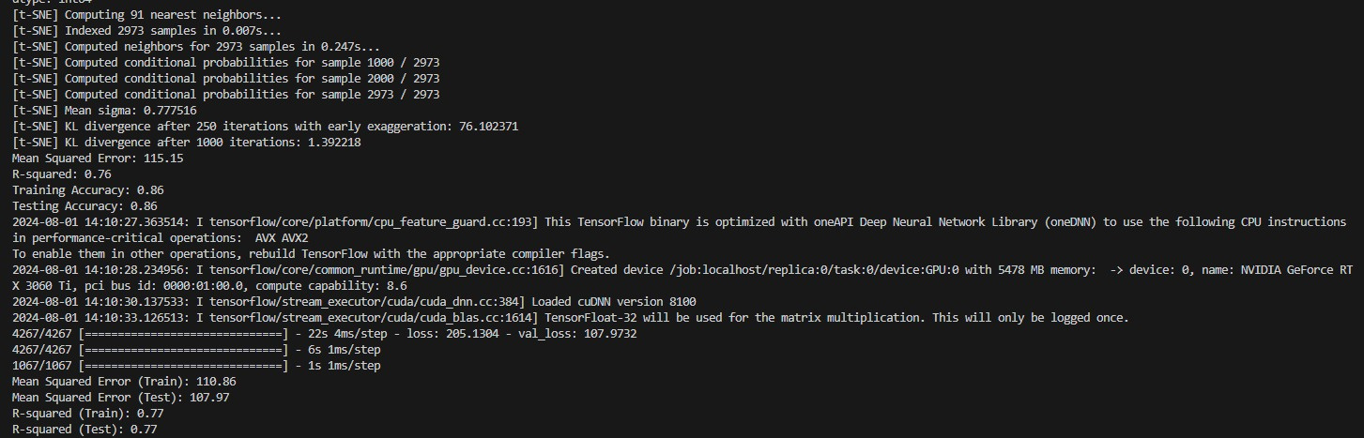
RESULTS &
EVALUATIONS
Performance metrics: Precision, recall, F1-score.
User feedback and its integration for system improvement

Slide 14
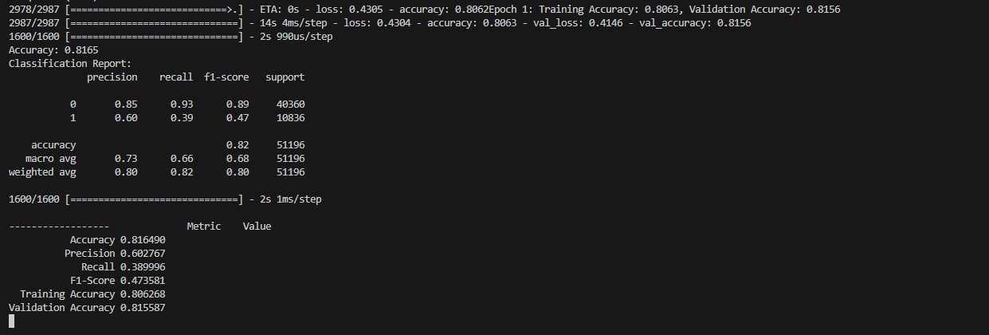
RESULTS &
EVALUATIONS
Performance metrics: Precision, recall, F1-score.
User feedback and its integration for system improvement

Slide 15
DATA PROCESSING
& MACHINE LEARNING TECHNIQUES
k-Means Clustering:
An unsupervised learning algorithm used to partition the dataset into clusters.
Groups similar users or songs based on their features.
Principal Component Analysis (PCA):
A dimensionality reduction technique.
Reduces the number of features while retaining most of the variance in the data, making it easier to visualize and process.
t-Distributed Stochastic Neighbor Embedding (t-SNE):
Another dimensionality reduction technique.
Good for visualizing high-dimensional data by reducing it to two or three dimensions.
StandardScaler:
A preprocessing technique used to standardize features by removing the mean and scaling to unit variance.
Ensures all features contribute equally to model performance.

Slide 16
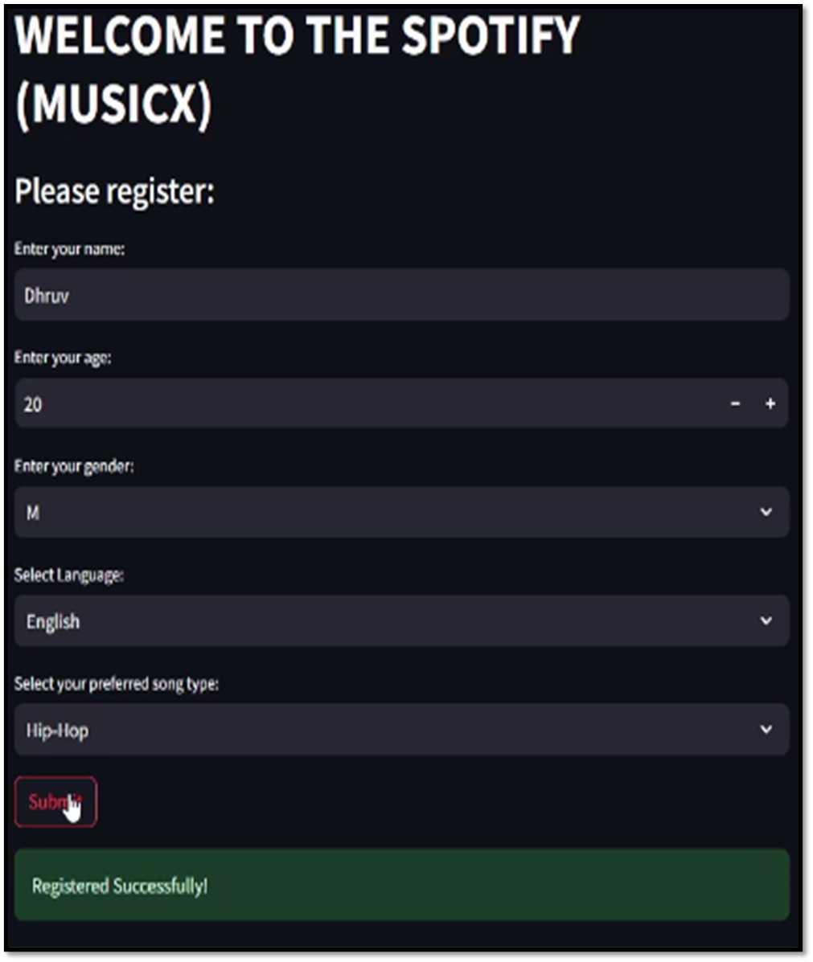
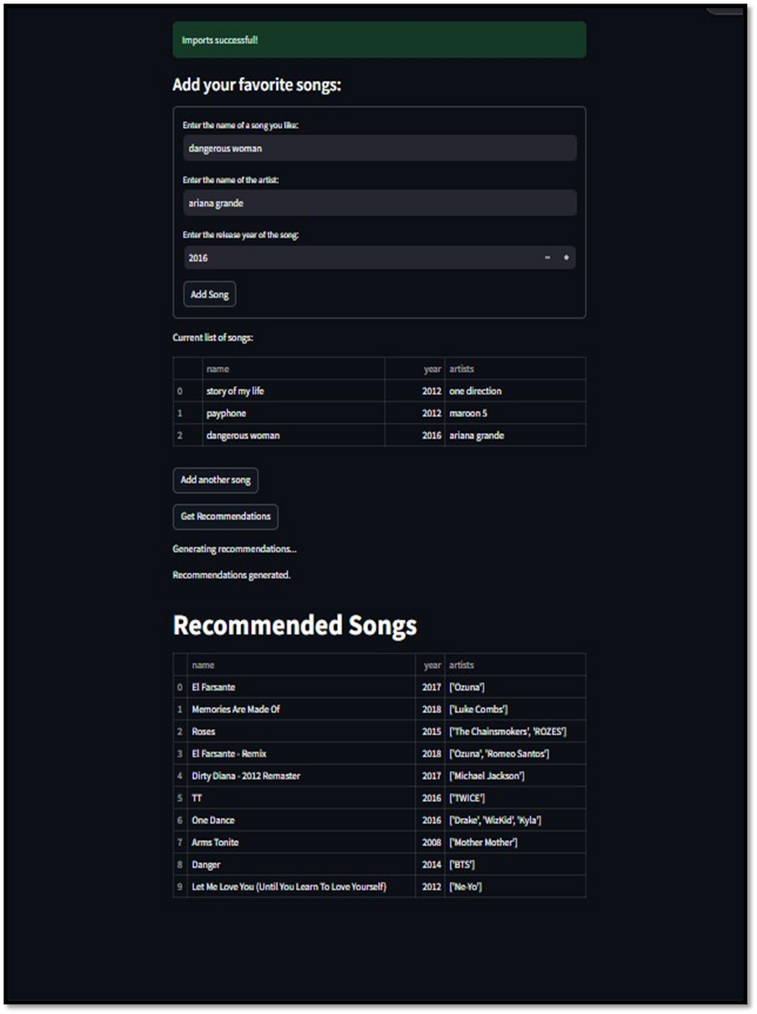
RESULTING OUTPUT

Slide 18


CONCLUSION
Improved Accuracy: Our hybrid recommendation system successfully enhances accuracy by combining collaborative filtering and content-based techniques.
User Satisfaction: Personalized recommendations tailored to individual tastes significantly boost user satisfaction.
Effective Personalization: Detailed user profiles and music features enable more precise recommendations.
Future Challenges: Scaling the system to accommodate a larger user base and addressing diverse musical preferences remain key challenges.
Ongoing Improvements: Continuously integrating user feedback ensures the system evolves to meet changing user needs and preferences.

Slide 19



MUSIC RECOMMEDATION SYSTEM
REFRENCES
Kaggle: https://www.kaggle.com/code/vatsalmavani/music-recommendation-system-using-spotify-dataset/notebook
Google-Colab: https://colab.research.google.com/drive/1H9BA3PXAiPxkfV9ciVXlbjXlfpSffAVy
ChatGPT & Claude.ai
Research Paper: https://www.researchgate.net/publication/360624328_An_Exploratory_Study_on_the_Spotify_Recommender_System
https://www.researchgate.net/publication/318511102_Recommender_System_Based_on_Collaborative_Filtering_for_Spotify's_Users
Youtube-Reference: https://youtu.be/gaZKjAKfe0s?si=U6fFL4R5Wd6GY0vZ

Slide 20




NEURAL NEXUS
DHRUV
DHAYAL
YUGANSH GUPTA
ADITYA RAJ
KSHITIJ KHANDELWAL
06313702022
08813702022
05513702022
01121102022

Slide 21


THANK U
ENJOY
THE
MUSIC

